Slide 1



Devops p1
Vadym kovalenko
WWW.ITEDUCATE.COM.UA
WWW.TRIANGU.COM

Slide 2
Determine what DevOps is?
Why it’s useful

Slide 3
Who is this course for
Anyone that wants to know more about DevOps

Slide 4
Who Should I already know
You should be familiar with some aspects of software development

Slide 5
Definitions
The development, deployment and operations pipeline, is the pipeline your software flows through

Slide 6
Do I need this course
If you’re deploying multiple times per day… probably not

Slide 7
Content
What is DevOps?
Why is culture important?
Why is automation important?
Why are metrics important?
What it is
Why everyone’s talking about it

Slide 8
Devops BASE
What is DevOps
?

Slide 9

Devops BASE
DevOps is a Philosophy

Slide 10
Devops BASE
The philosophy of the efficient development, deployment, and operation of the highest quality software possible…

Slide 11

Devops BASE
DevOps (a clipped compound of "development" and "operations") is a software engineering culture and practice that aims at unifying software development (Dev) and software operation (Ops).

Slide 12
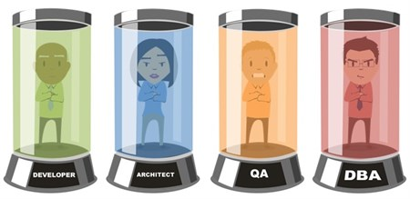
Devops BASE
Often problematic

Slide 13
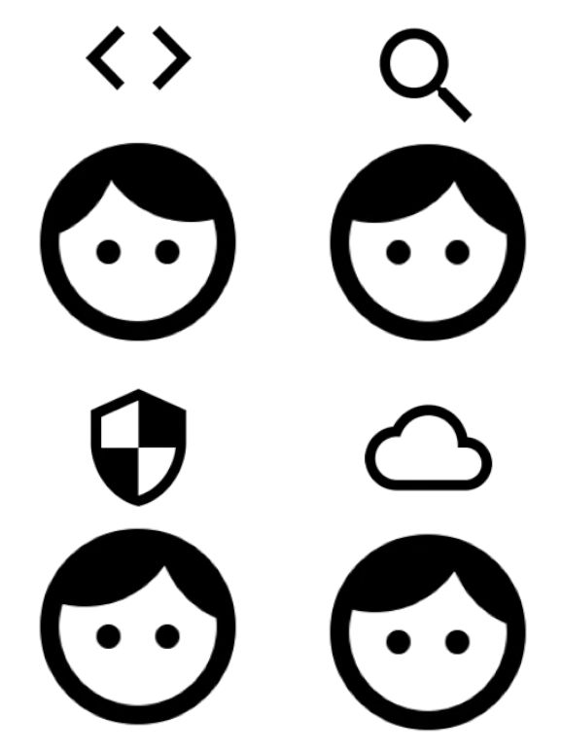
Devops BASE
Cross-functional team: useful

Slide 14
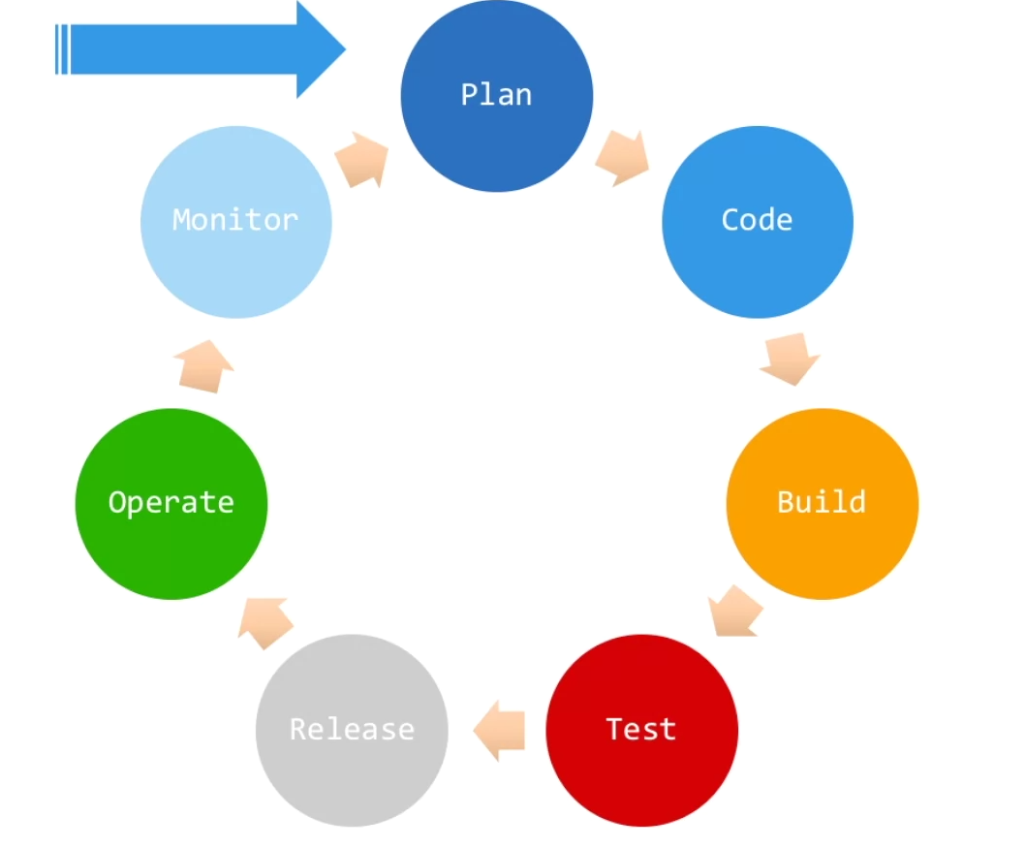
Devops BASE
Cross-functional team: useful

Slide 15
Devops BASE
Why DevOps exists?

Slide 16
Devops BASE
Development
Operations
DevOps

Slide 17
Devops BASE
Remain stable or Go fast?

Slide 18
Devops BASE
Culture: One Team, One Goal

Slide 19
Devops BASE
Automation: Start The Robotocracy

Slide 20
Devops BASE
Measure: All The Things

Slide 21

Devops BASE
I can’t wait to try that site everyone’s talking about!

Slide 22
Devops BASE
Where did my data go?

Slide 23
Devops BASE
How did such an obvious and testable bug make it into production?

Slide 24
Devops BASE
How long does it take you to get new features into production?

Slide 25
Devops BASE
DevOps can help…

Slide 26
Devops BASE
Not a product
Not a brand
Not a job title or team
Not any one thing

Slide 27
Devops BASE
Culture Automation Measurement

Slide 28
Devops BASE
You know what DevOps is

Slide 29
Devops BASE
...and the problem it’s trying to solve

Slide 30
Devops BASE
Development
Operations

Slide 31
Content
What is DevOps?
Why is culture important?
Why is automation important?
Why are metrics important?
What does DevOps culture mean

Slide 32
Devops BASE
Culture is the vision, values, beliefs and the habits of a company

Slide 33

Devops BASE
I don’t want to change!

Slide 34
Devops BASE
What changes need to happen?

Slide 35
Devops BASE
Delaying new features costs money!

Slide 36
Devops BASE
Everyone working toward a common goal!

Slide 37
Devops BASE
Shared Responsibility: What’s my role now?

Slide 38
Devops BASE
A “DevOps team” usually creates another silo!

Slide 39
Devops BASE
Silos promote a “blame culture”!

Slide 40
Devops BASE
Focus on collaboration and transparency

Slide 41
Content
What is DevOps?
Why is culture important?
Why is automation important?
Why are metrics important?
What it is
Why it matters to DevOps

Slide 42
Devops BASE
“the technique, method, or system of operating or controlling a process by highly automatic means, as by electronic devices, reducing human intervention to a minimum ”

Slide 43

Devops BASE
Your goal

Slide 44

Devops BASE
Your result

Slide 45


Devops BASE
I can make that!
This Photo by Unknown Author is licensed under CC BY-SA

Slide 46
Devops BASE
Error 50002: Bad recipe!
This Photo by Unknown Author is licensed under CC BY-SA

Slide 47
Devops BASE
That’s better!
This Photo by Unknown Author is licensed under CC BY-SA

Slide 48
Devops BASE
What was I doing?

Slide 49
Devops BASE
Automation provides a level of consistency, predictability, scalability and quality…

Slide 50
Devops BASE
Find the constrains

Slide 51
Devops BASE
Where to start?

Slide 52
Devops BASE
Start simple

Slide 53

Devops BASE
Start with CI

Slide 54
Devops BASE
Don’t stop there

Slide 55
Devops BASE
Automation helps your development, deployment and operations pipeline move faster

Slide 56
Content
What is DevOps?
Why is culture important?
Why is automation important?
Why are metrics important?
What metrics should we track

Slide 57
Devops BASE
Are your efforts making a difference?

Slide 58
Devops BASE
Each role has metrics they care about

Slide 59
Devops BASE
#1 Frequency of Deployments

Slide 60
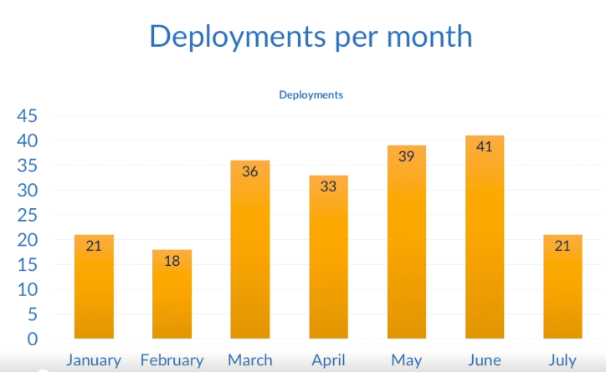
Devops BASE

Slide 61
Devops BASE
#2 Mean time to recover/repair/resolve(MTTR)

Slide 62
Devops BASE
MTTR is the average amount of time it takes you to resolve problems with your production environment

Slide 63
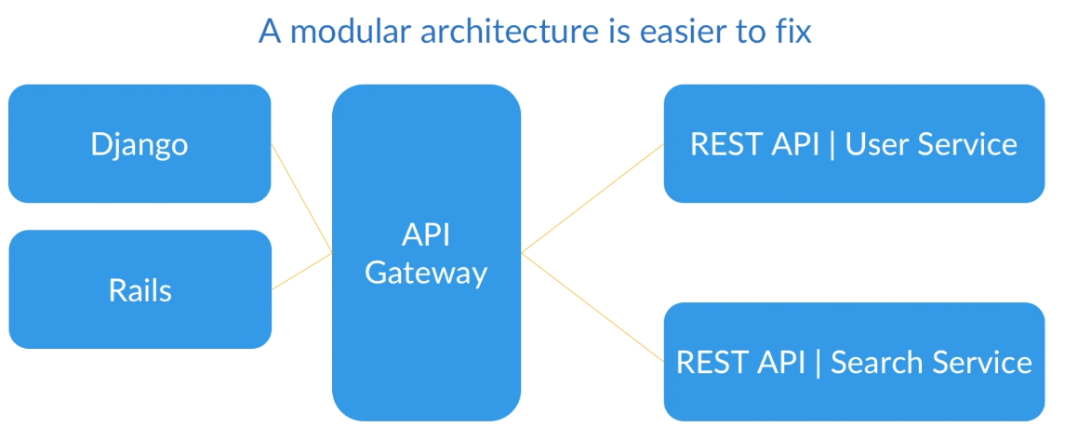
Devops BASE

Slide 64
Devops BASE
#3 Mean time to discovery(MTTD)

Slide 65
Devops BASE
#4 System availability

Slide 66
Devops BASE
Know the availability of your systems!

Slide 67
Devops BASE
#5 Service performance

Slide 68
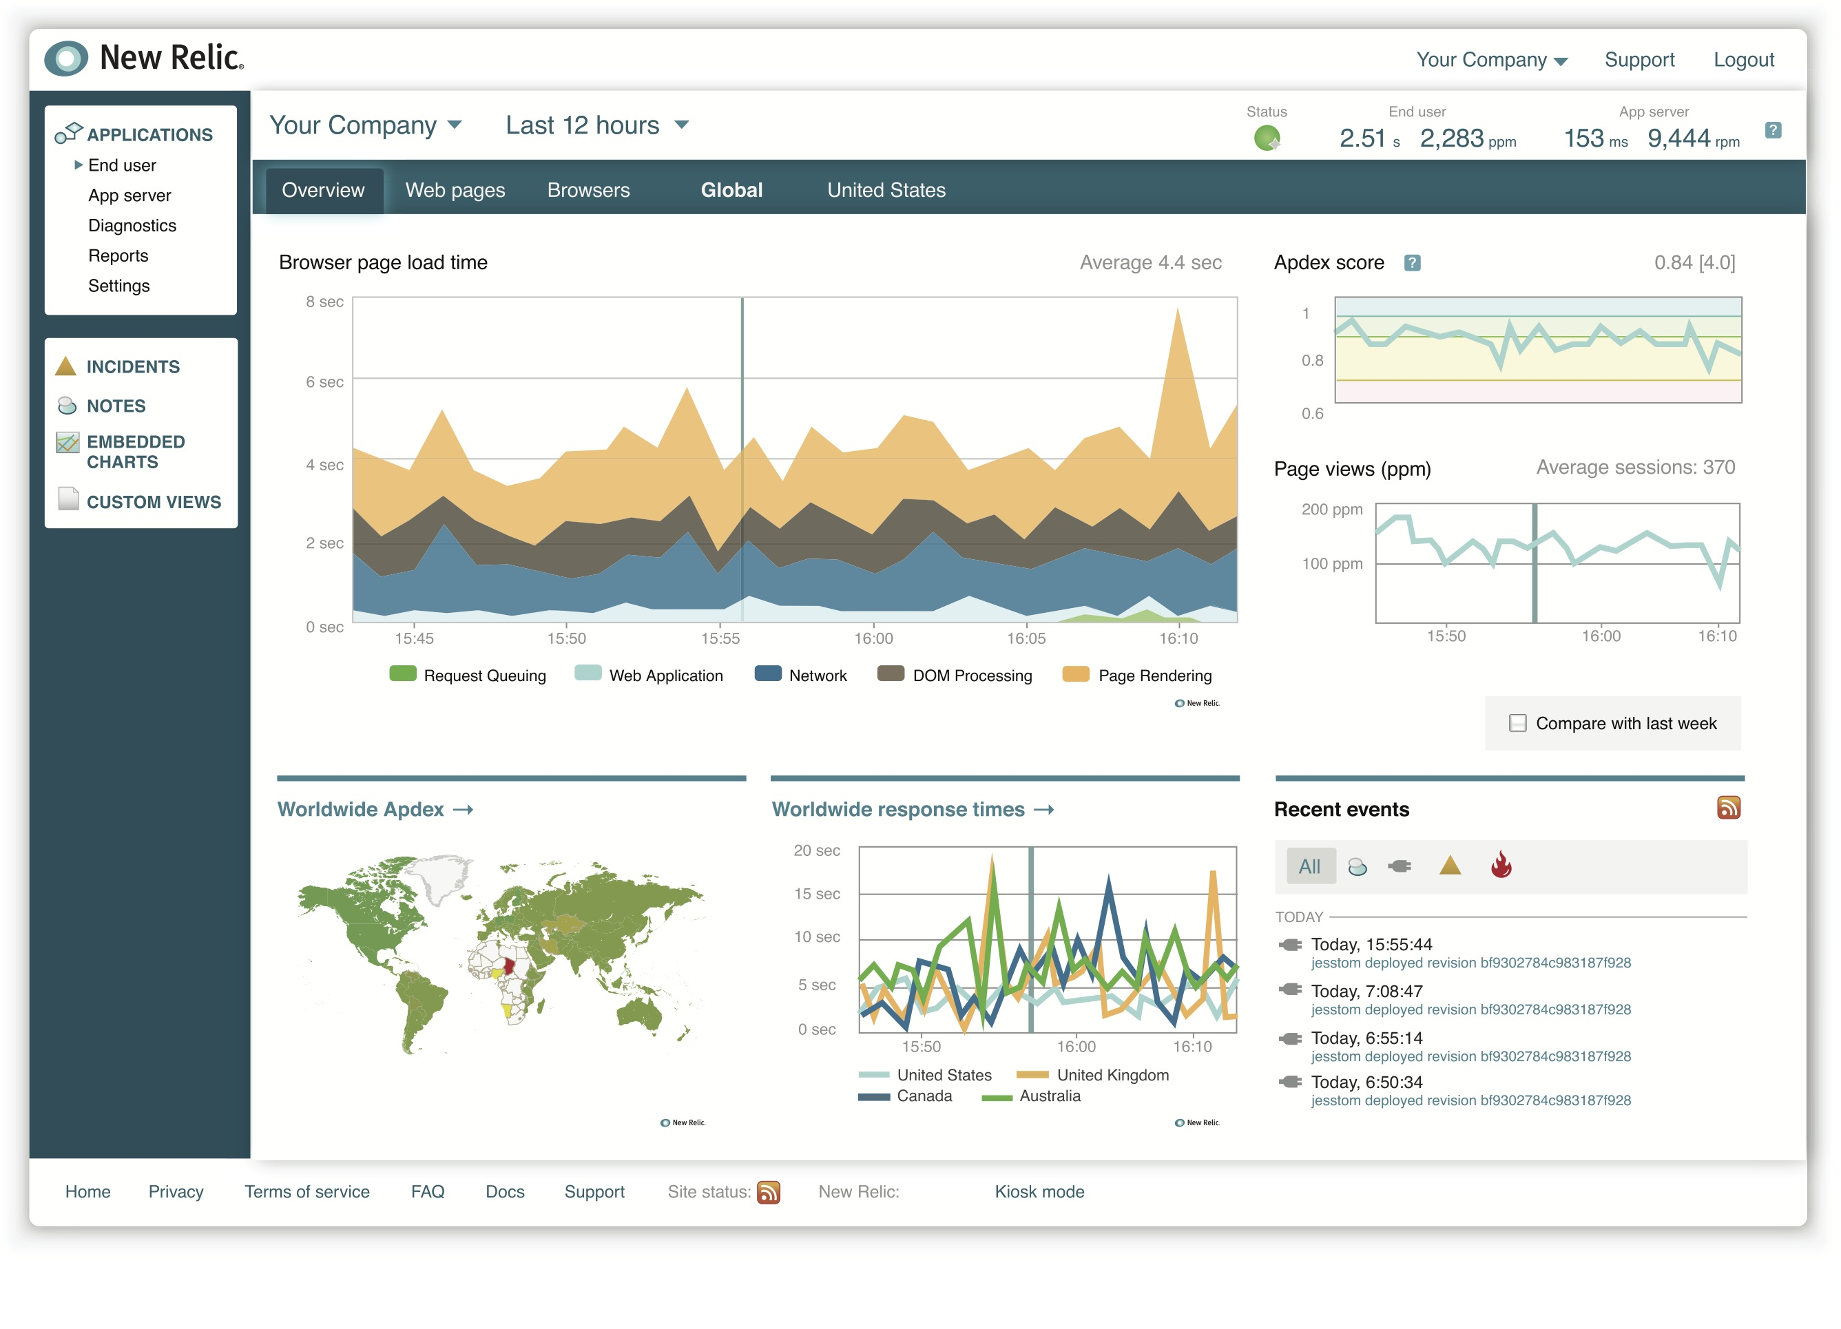
Devops BASE
Tools like New Relic can help
This Photo by Unknown Author is licensed under CC BY-NC-SA

Slide 69
Devops BASE
#6 Customer complaints

Slide 70


Devops BASE
What sort of tickets are users creating?
500 error when clicking my account
I need to be able to export my data

Slide 71
Devops BASE
#7 Lead Time

Slide 72
Devops BASE
Lead Time
Feature requested
Feature released

Slide 73
Devops BASE
Metrics should be used to help enhance the efficiency of your development and deployment process

Slide 74
Devops BASE
What companies practice DevOps?

